Slide 1
Connecting Science and Life with Trust
Ethos in Fukushima
Ryoko ANDO
October 3, 2018
APPLICABILITY OF RADIATION-RESPONSE MODELS TO LOW DOSE PROTECTION STANDARD

Slide 2
Self Introduction
Ryoko ANDO
Resident in Iwaki-shi, FUKUSHIMA
Born and grew up in HIROSHIMA
After FUKUSHIMA Dai-ichi NPP accident…
NPO ETHOS IN FUKUSHIMA

Slide 3
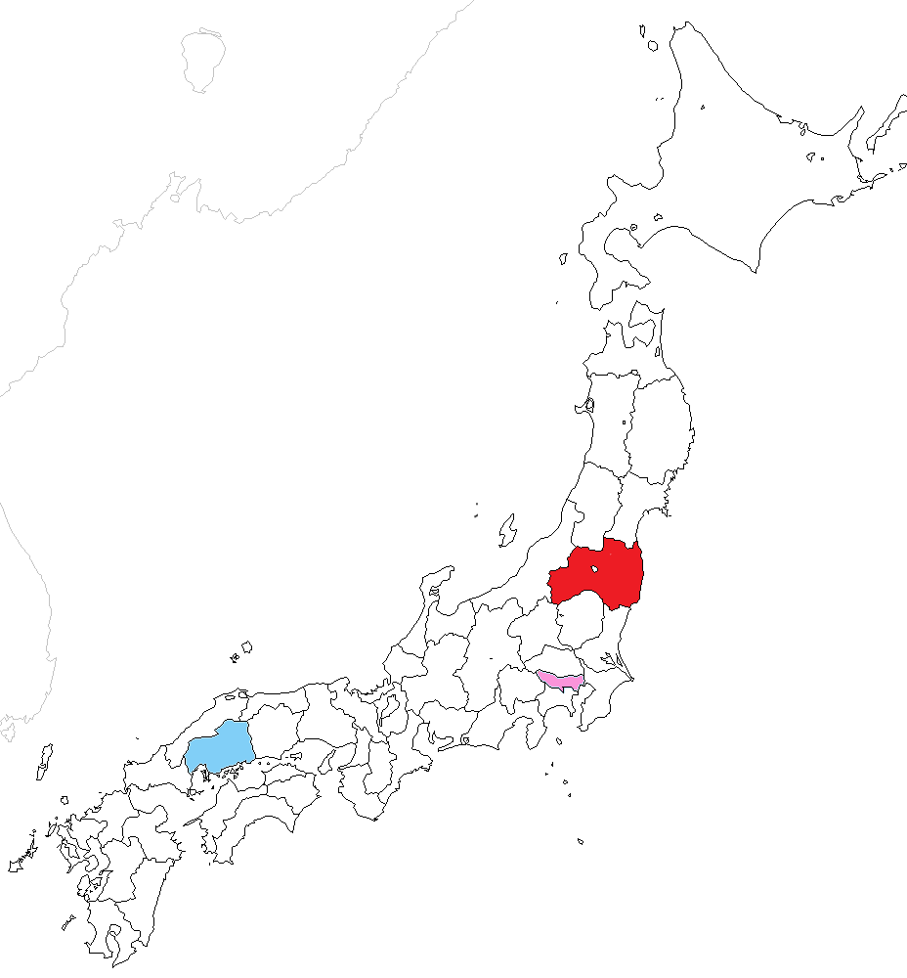
Where is Fukushima and Hiroshima?
Fukushima
Hiroshima
250km
800km
Tokyo
Notes:
Fukushima is in the North-east region of Japan..

Slide 4
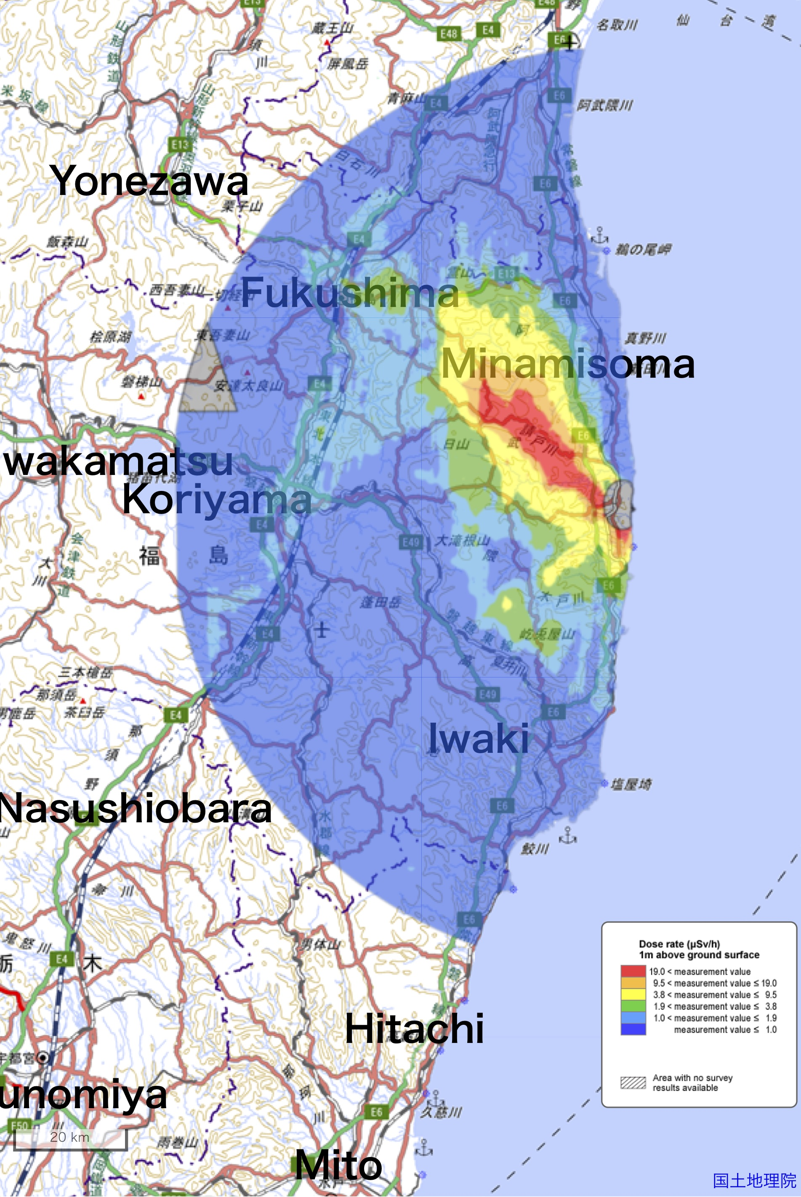
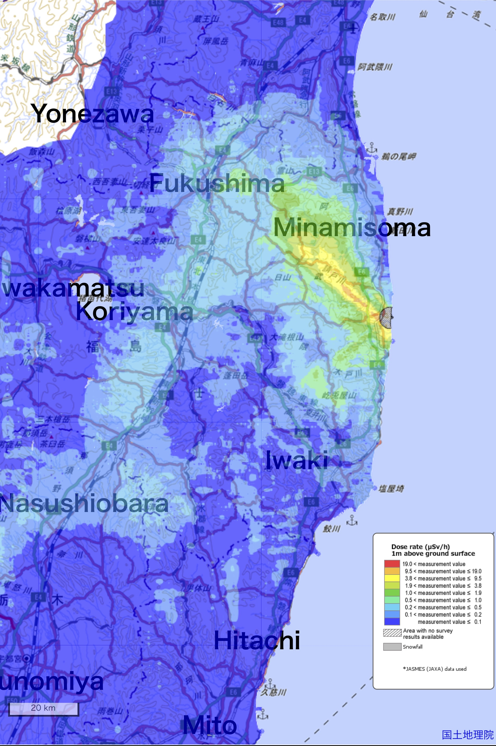
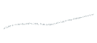
Distribution Map of Radiation Dose
As of April 29, 2011
As of November 16, 2017
©️Extension Site of Distribution Map of Radiation Dose, etc.,/GSI Maps https://ramap.jmc.or.jp/map/eng/

Slide 5
Monitoring Results of
Agricultural/Fishery Products in Fukushima Pref.
From Fukushima Prefecture http://www.pref.fukushima.lg.jp/site/portal/89-4.html

Slide 6
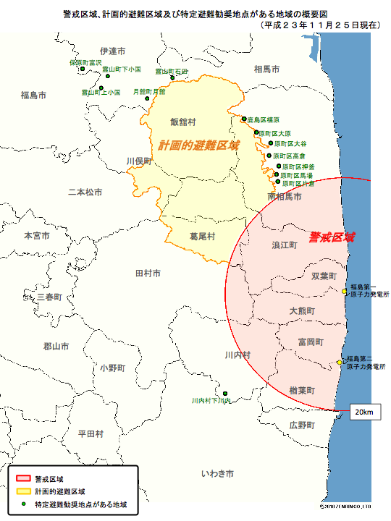
As of September 30, 2011
Deliberate Evacuation Area
Restricted area
20 km
http://www.meti.go.jp/earthquake/nuclear/pdf/111125d.pdf
Notes:
2011年11月

Slide 7
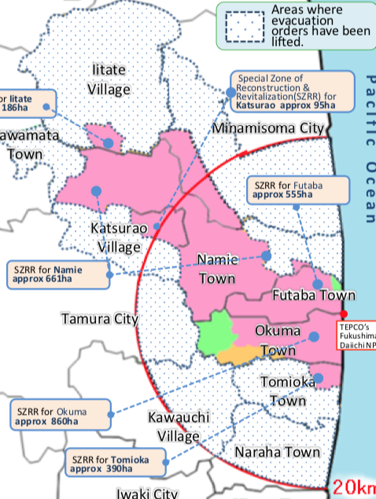
As of April 1, 2017

Slide 8
Distrust of Government/Experts has Intensified after the Accident
Occurrence of the accident itself
Before the accident: ”NPP accident will never happen in Japan”
Explanations went back and forth
Beginning: Overly optimistic outlook
Then: Situation getting worse and worse than expected
April 2011: Criterion for resuming schools: 3.8 μSv/h
May 2011: A government advisor resigned in protest
April 2012: Revise of food safety standard: 500 bq/kg -> 100 bq/kg
Notes:
2011年4月22日の区域再編後

Slide 9
Common factor: After-the-fact changes
It intensified distrust that they changed what they says
without enough explanation to the public.
Notes:
2011年4月22日の区域再編後

Slide 10
Activity of Suetsugi

Slide 11
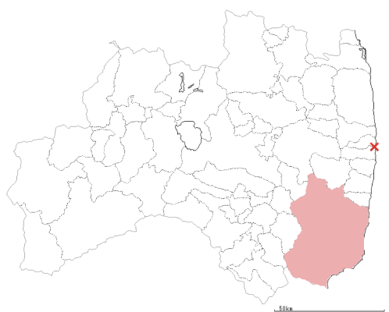
Where is Suetsugi, Iwaki-shi?
30 km
20 km
NPP
●Suetsugi
Iwaki

Slide 12
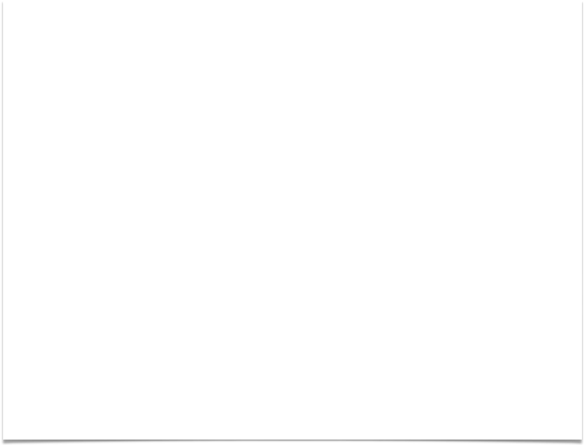
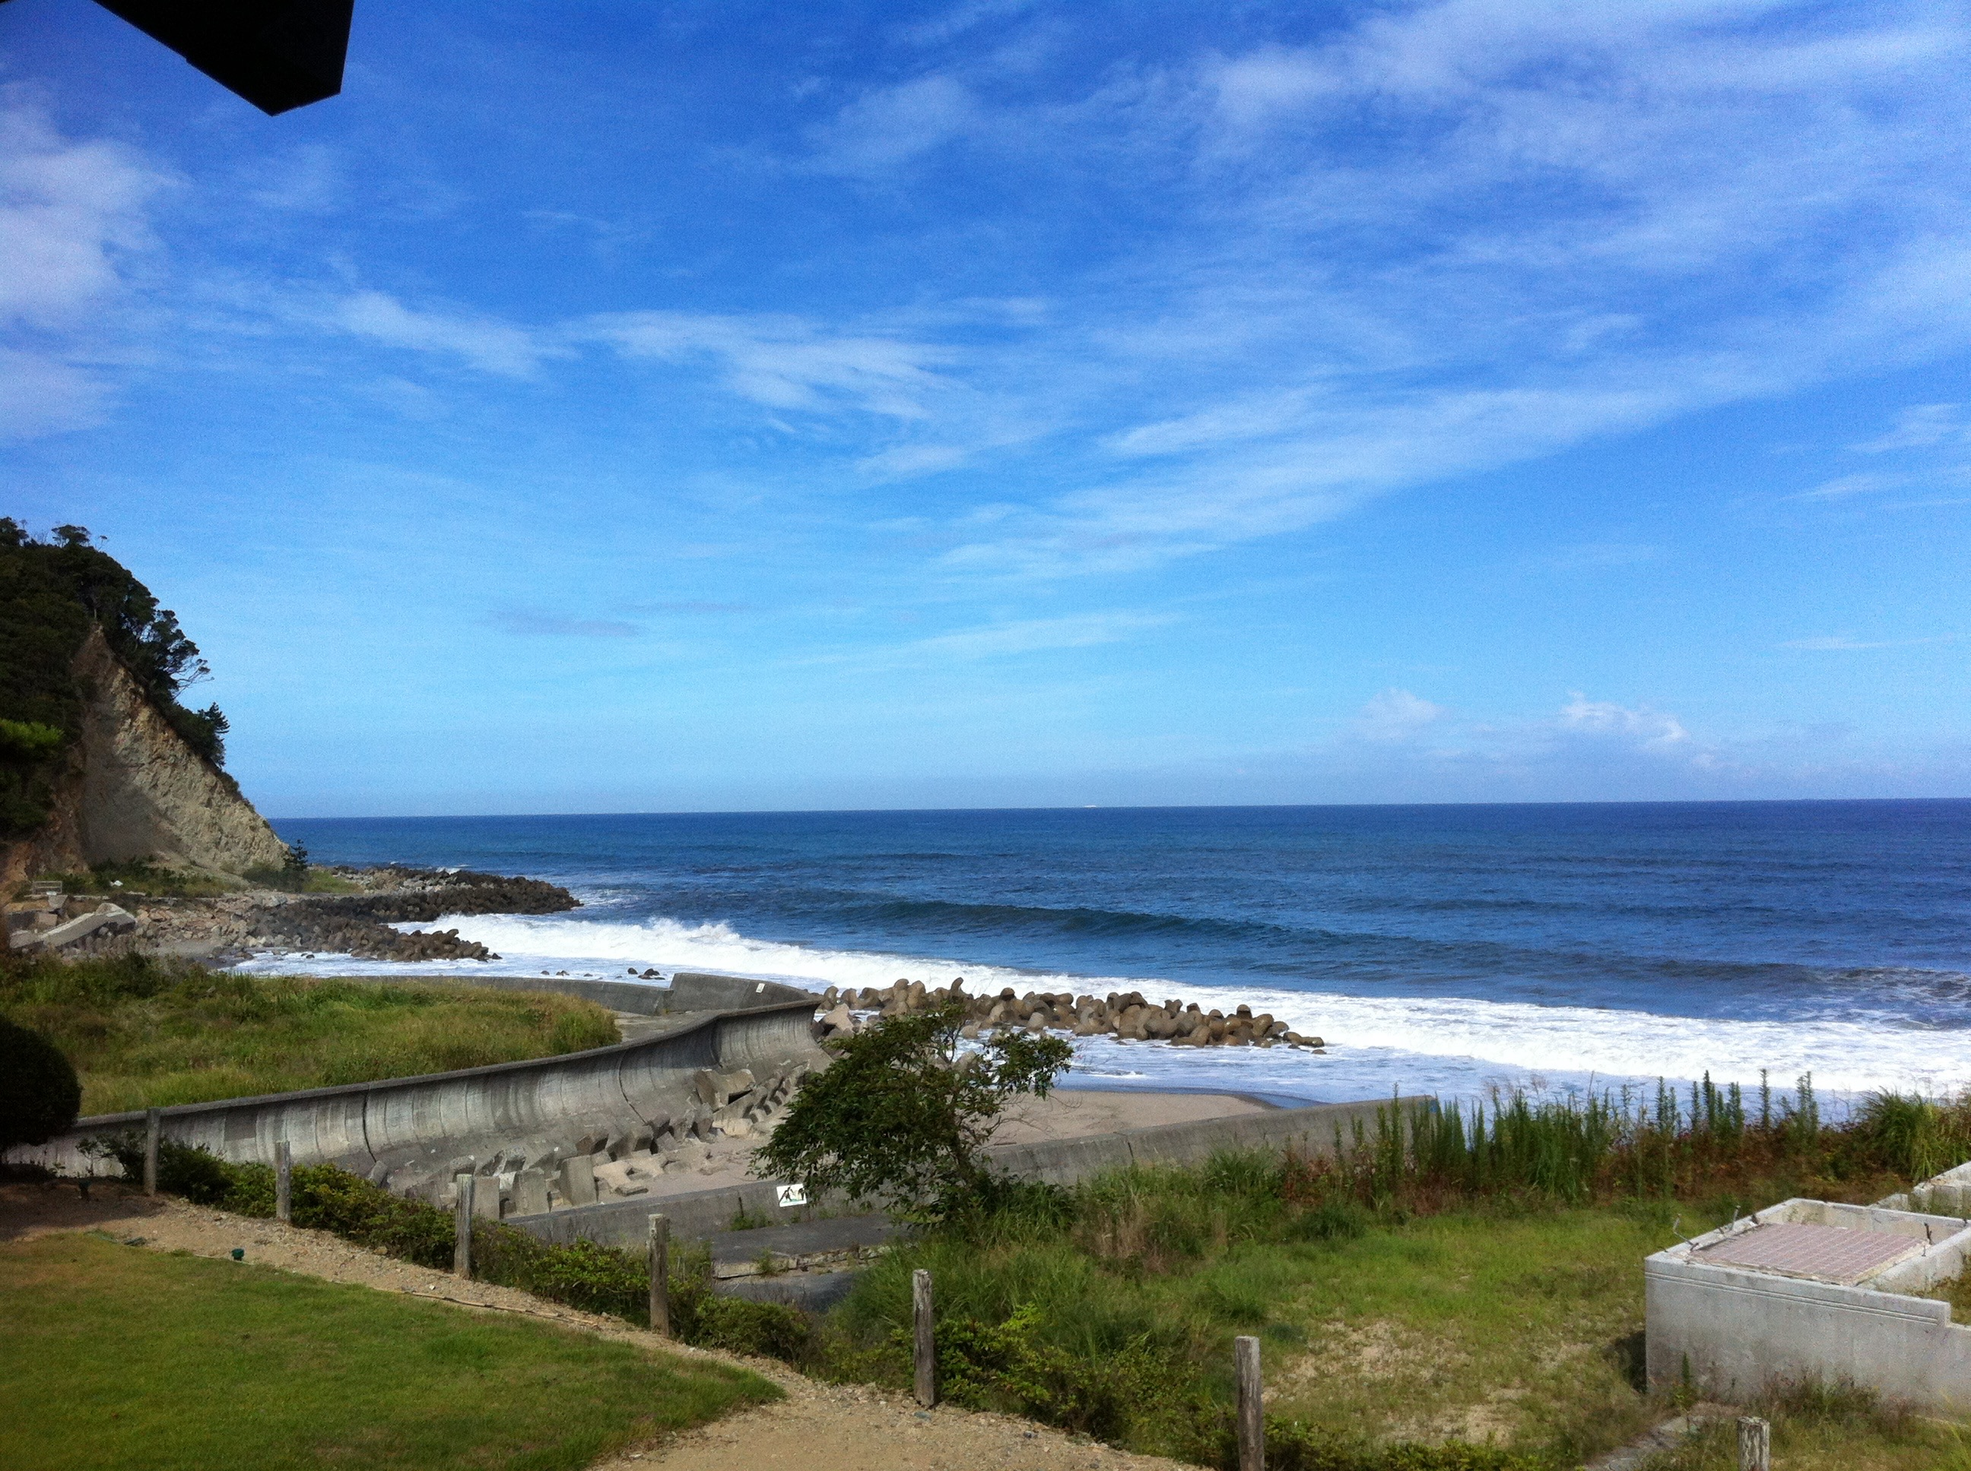
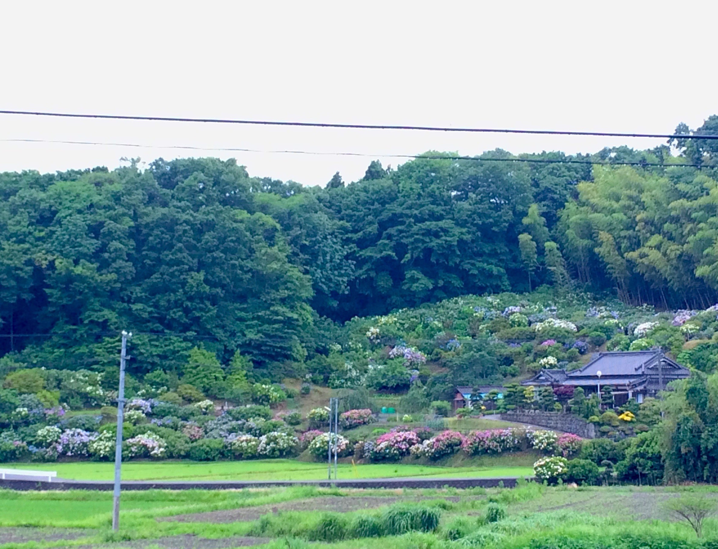
Situation of Suetsugi
100 plus households
about 400 people (April 2014)
within 20-30 km from the NPP
March 12 – April 22, 2011
Designated as indoor sheltering zone;
residents were requested to evacuate, almost all residents had been evacuated

Slide 13
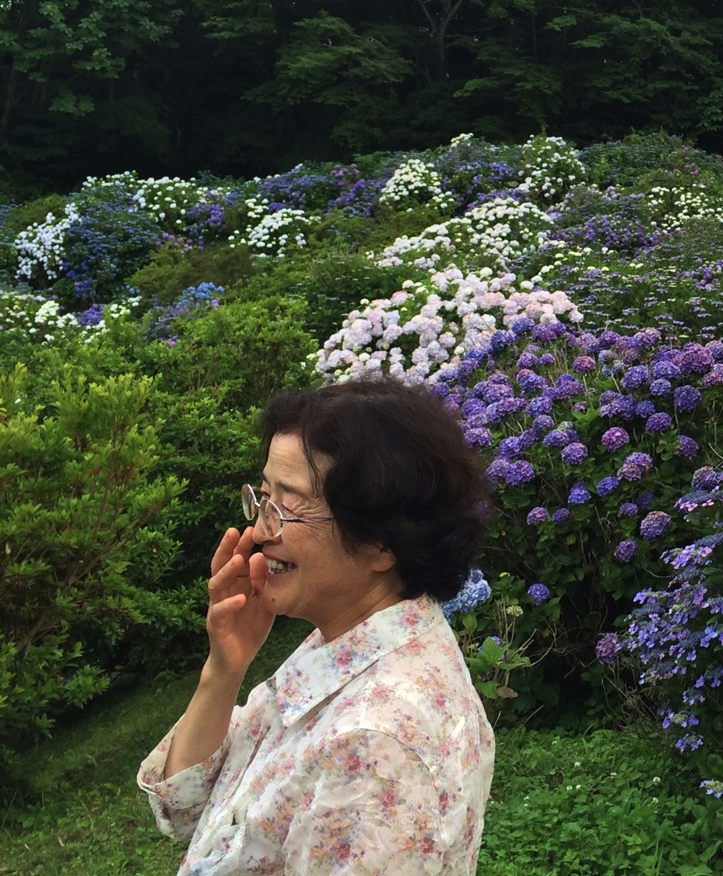
Lacking Information
General information was flooding around.
What was lacking?
Information necessary for daily life
Information of radioactivity familiar to daily life
Information from reliable people

Slide 14
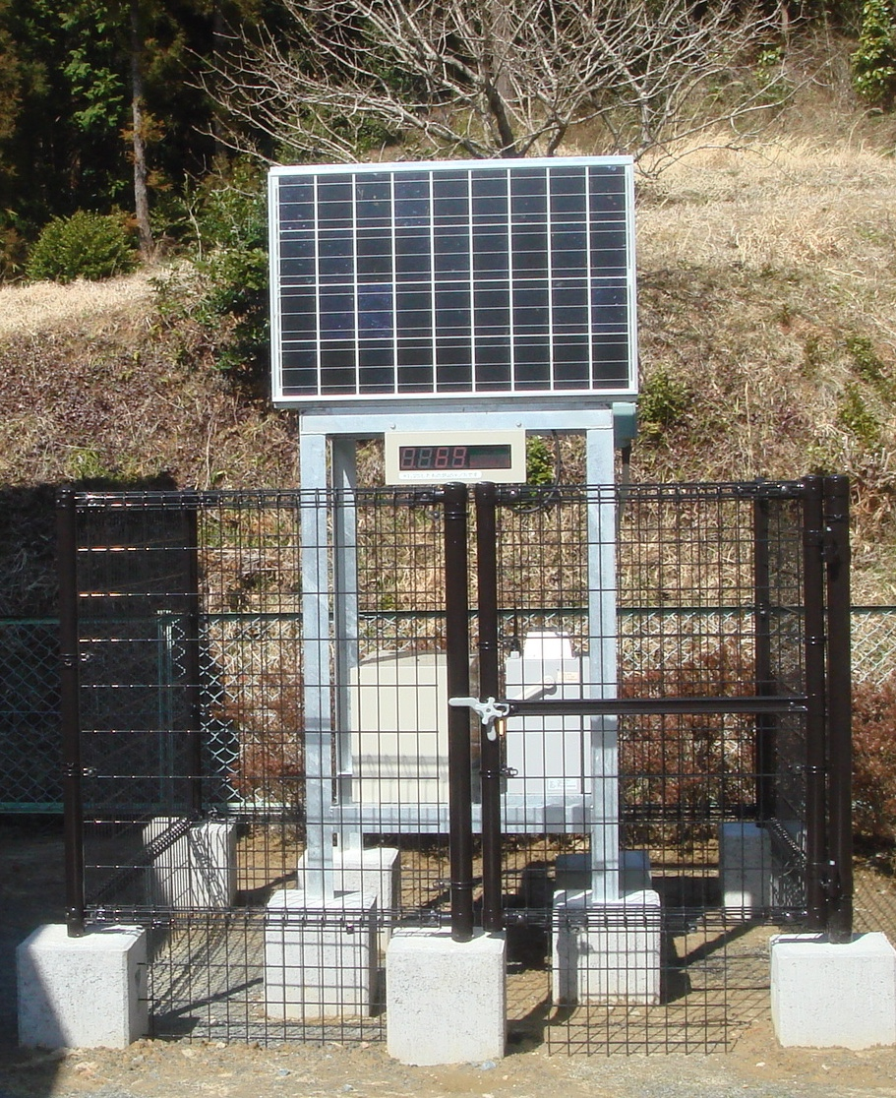
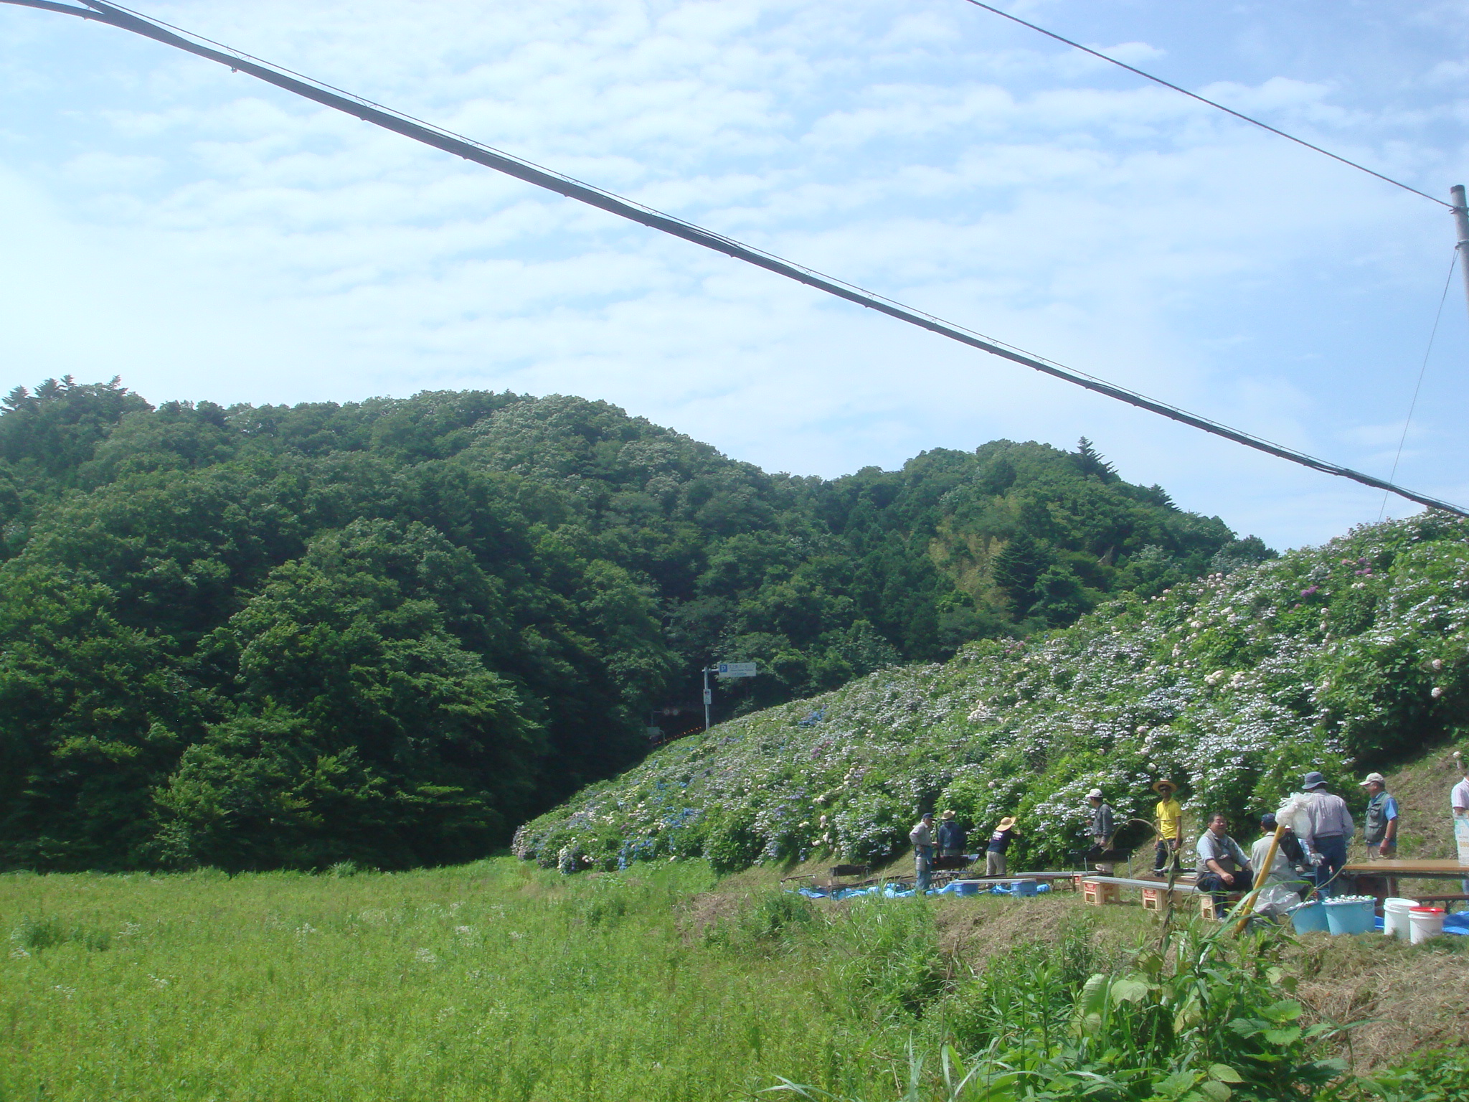
Do You Trust the Environment You Live in?
dangerous?
dangerous
dangerous?
safe?
dangerous?
Notes:
Even after voluntary evacuation request was lifted, many families, especially the young did not come back.
Those who came back could not farm, or pick from their vegetable garden.
2012年7月。画面右手は田んぼ。人々は戻ってきたけれど、放射能が不安で米を育てようとしなかった。
The situation at FNPP No.1 was still unstable. The media was full of grim speculation about damage from radiation.

Slide 15
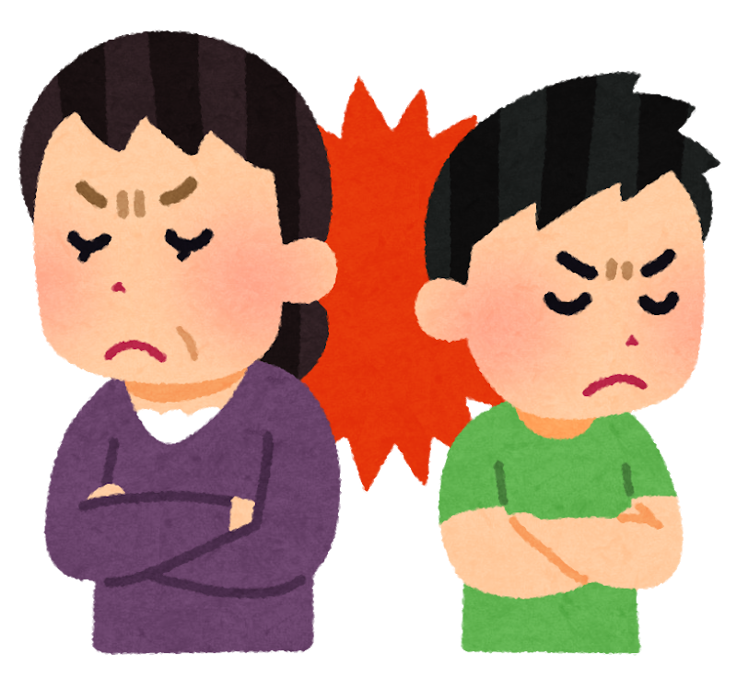
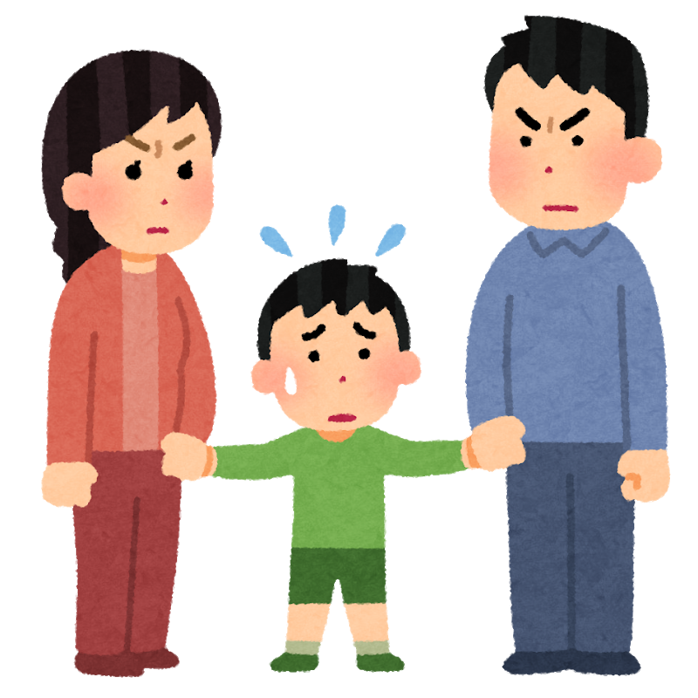
Trust in Human Relationships was Lost
Lost common understanding for the trust on daily life environment
- Is it safe, or not?
Disputes even within a family or among friends
One can’t continue smooth communication with a neighbor who meets everyday in face-to-face
Breakup of a family
Divorce

Slide 16
Three Measurements Done in Suetsugi
External exposure measurement using wearable dosimeters
Internal exposure measurement through WBC
Foodstuff measurement brought in from residents

Slide 17
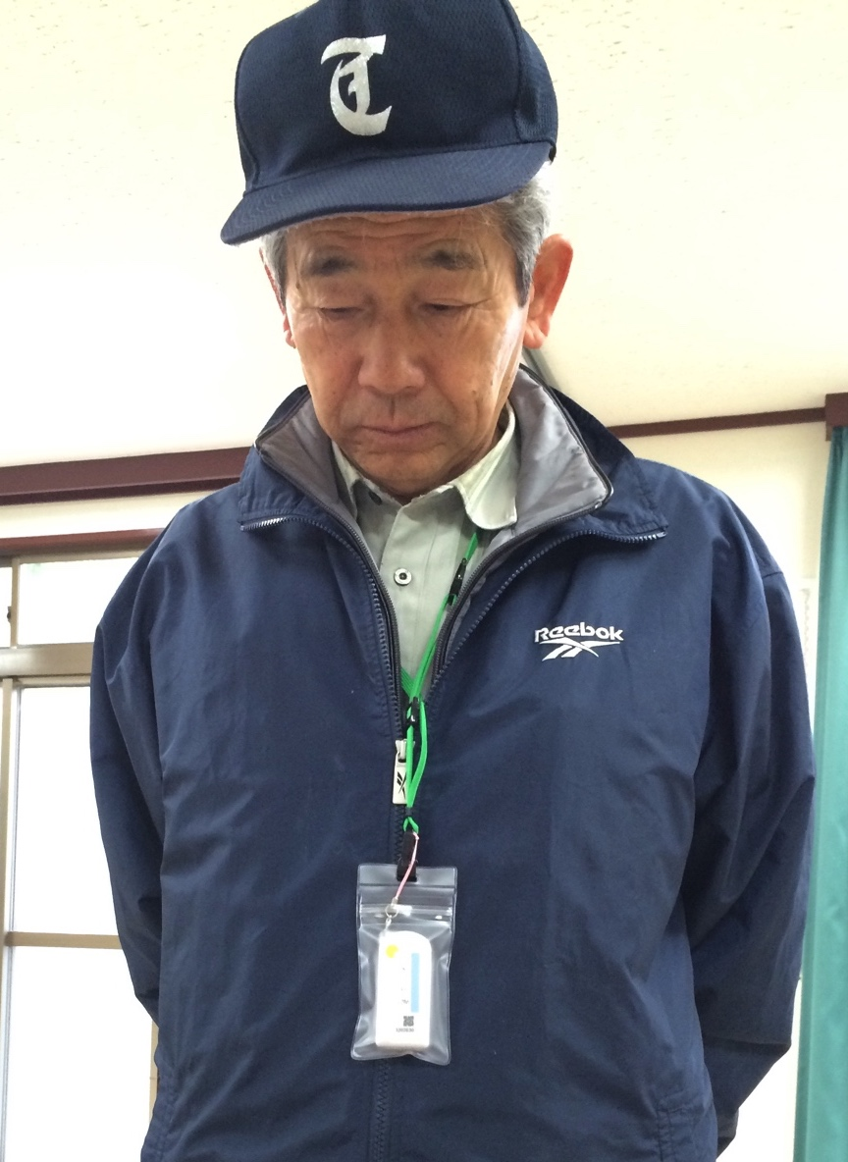
External Exposure Management
From 2012
From 2014, community-wide measurements were done as a district
At most 120 people joined the measurement

Slide 18
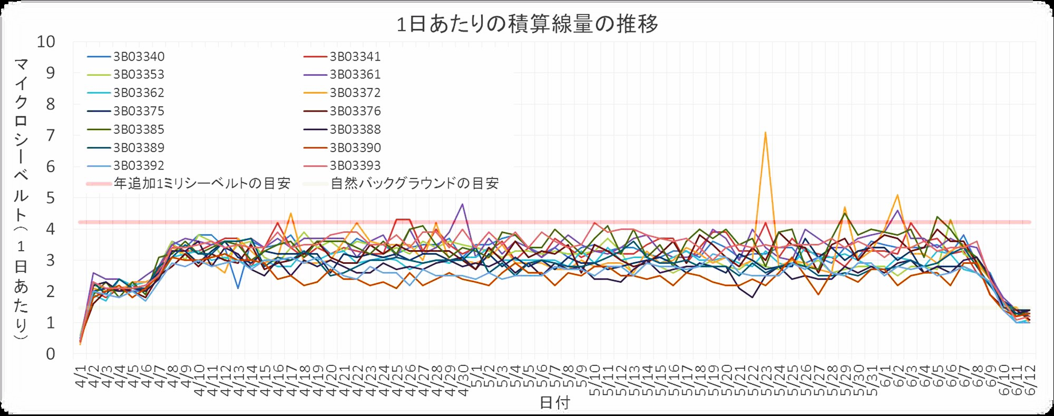
Grasping External Exposure as Whole District Community
Daily accumulated dose (μSv)
additional exposure dose 1mSv/y
natural background dose
Graph made by Dr Makoto Miyazaki, Fukushima Medical University
Grasp exposure in each one’s life space and in community-level
Notes:
生活圏、測るという意志、暮らしへの意志

Slide 19
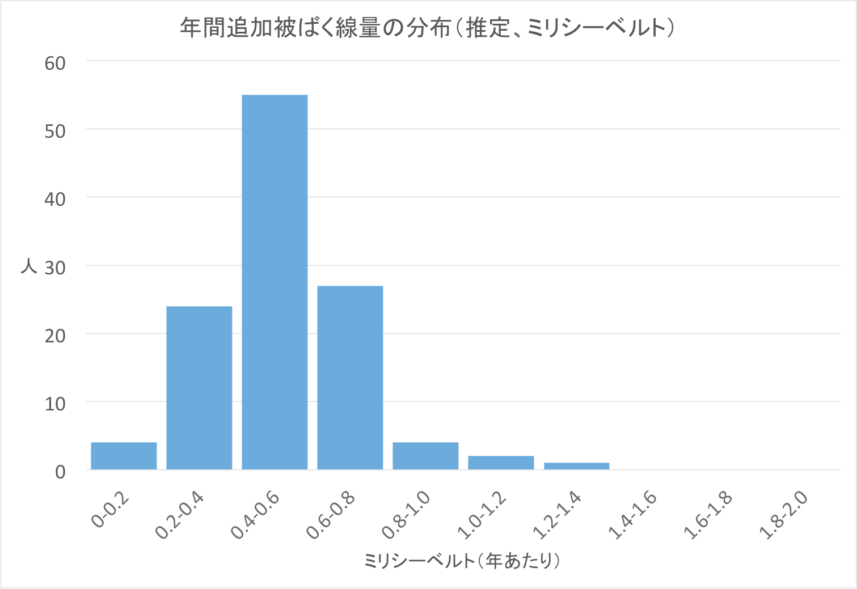
Distribution of External Exposure as District Community
Estimated additional exposure dose 1 mSv/y
person
mSv/y
Graph made by Dr Makoto Miyazaki, Fukushima Medical University

